Slide 1

Grow Mate
Projeto em Informática – Sensing My Home
Licenciatura em Engenharia Informática
Grupo 5
Notes:
Daniel

Slide 2
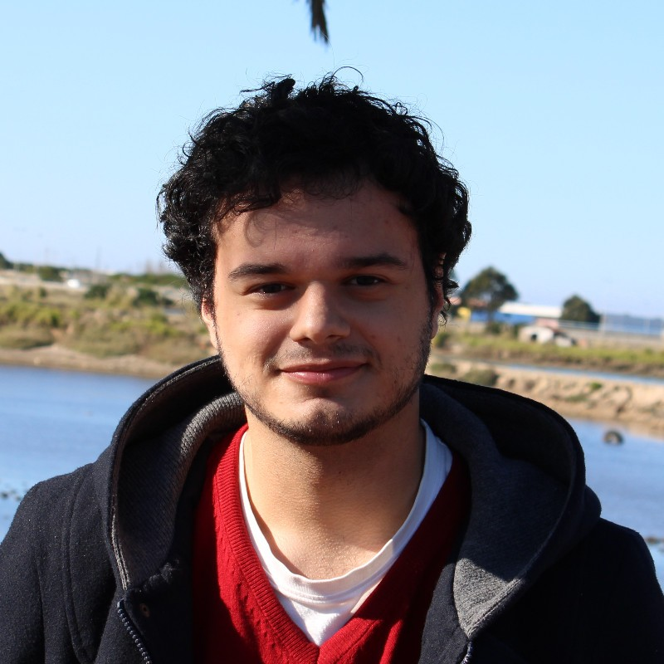
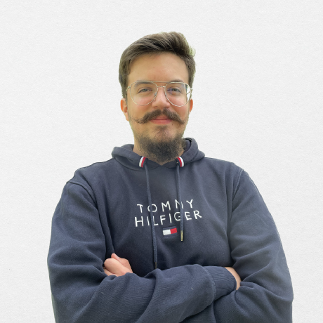
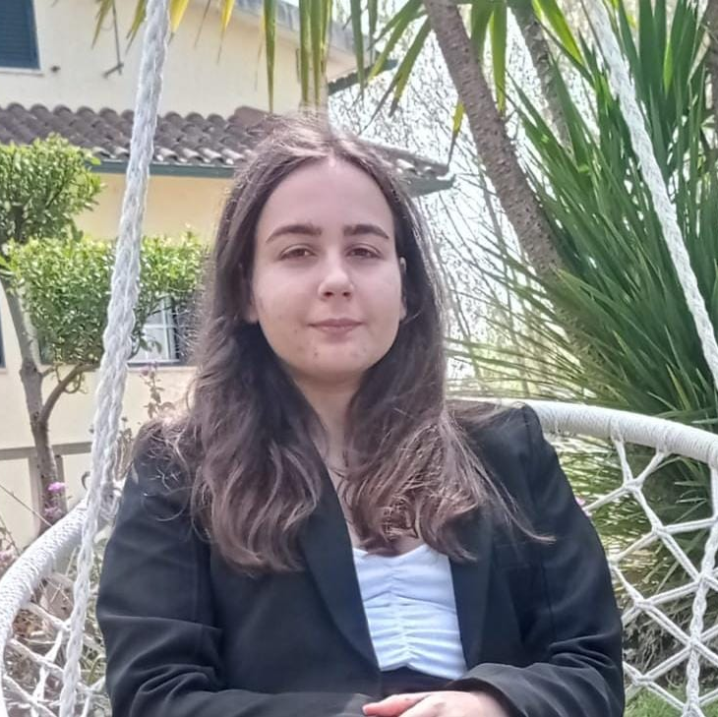

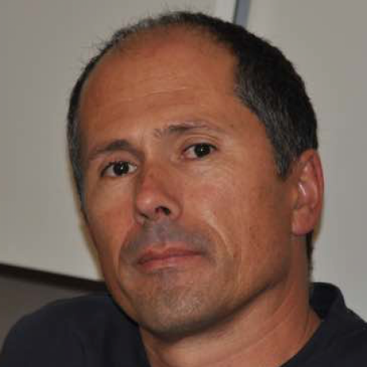
The Team
Artur Correia
André Butuc
Bruna Simões
Daniel Carvalho
José Luís Oliveira
(Advisor)

Slide 3
Project Presentation

Slide 4
Context
40%
Growing plants has always been a popular hobby amongst households, but also a difficult one, since there are different types of plants that need specific care.
The demand for indoor plants grew 18% during the Covid-19 pandemic and nowadays 7 in 10 millennials call themselves a plant parent.
The availability in technology and its further growth in the market led to the development of useful systems for monitoring and helping the owners creating optimal conditions for their plants.
Source: https://gardenpals.com/houseplant-statistics/

Slide 5
Problem
Each species requires its own specific acclimatization process.
Individuals with limited experience may struggle to provide adequate care for certain plants.
The daily demands of life can cause individuals to overlook the necessary maintenance required to keep their plants healthy.
Finding new species to cultivate can be a challenging and time-consuming task.
Notes:
--- Daniel ---

Slide 6
Main Goals
Facilitate the acclimatization process of plant species.
Provide daily reminders and suggestions to assure that the plants are receiving its proper needed care.
Suggest plant species that follow similar growth patterns and behavior.
Notes:
Artur

Slide 7
Personas & Motivations
Motivation | Personas
 | “The Novice Gardener” | “The Busy Professional” | “The Plant Enthusiast”
Scenarios | They are excited to get started on their new hobby, but they have no idea where to begin. Thus, they use the app to find plants suitable for novices, and to get tips on how to care for them. | Due to having a very busy professional life, they don’t have a lot of time to devote to their plants. As such, GrowMate provides them reminders for when it’s time to do activities related with plant care, such as watering or fertilizing. | They are an experienced gardener with a vast collection of plants. Thus, they use GrowMate to maintain their inventory updated, and to find suggestions for new plant varieties, suitable for experienced users, to grow.

Slide 8

Functional Requirements
House plants inventory and management
Scheduling tasks for plant maintenance
Suggestion of similar plants
Integration of measurements performed by sensors
Task notifications/reminders
Suggestion of optimal conditions for each plant​

Slide 9

Expected results
Mobile application
Sensors’ integration and monitoring
Database of several plant species conditions and characteristics, accessed via an API

Slide 10


Related Work
#1
#2
Flower Care
Plant Identifier & Care - Greg
#4
Notes:
--- Artur ---

Slide 11
Project Calendar
Notes:
Bruna

Slide 12
Milestone Schedule
Milestone 1
Presentation of the lifecycle objectives and calendar for the project
Milestone 2
Presentation of the lifecycle architecture
Milestone 3
Protoype; Mid-Term Presentation
Milestone 4
Project Presentation
Milestone 3.1
Milestone 4.1
28/02
14/03
11/04
30/05
24/03
01/05
MARCH
APRIL
MAY
Integration of additional features
Deployment infrastructure stabilization
Defining core user stories
Non-Functional UI prototypes
Database
Modellling
API and backend stabilization
Final development of the UI
Developing the remaining user stores
Finalizing functional and non-functional requirement analysis
Determining which sensors to integrate in the system
Defining the problem domain
UI Development based on the main core user stories
Sensor data generation and integration basic pipeline
Core user stories implemented for the demonstration of the full-stack architecture

Slide 13
Milestone Schedule
Milestone 1
Presentation of the lifecycle objectives and calendar for the project
Milestone 2
Presentation of the lifecycle architecture
Milestone 3.1
28/02
14/03
24/03
MARCH
Defining core user stories
Non-Functional UI prototypes
Database
Modellling
Finalizing functional and non-functional requirement analysis
Determining which sensors to integrate in the system
Defining the problem domain

Slide 14
Milestone Schedule
Milestone 3
Protoype; Mid-Term Presentation
Milestone 3.1
Milestone 4.1
11/04
24/03
01/05
MARCH
APRIL
API and backend stabilization
Final development of the UI
Developing the remaining user stores
UI Development based on the main core user stories
Sensor data generation and integration basic pipeline
Core user stories implemented for the demonstration of the full-stack architecture

Slide 15
Milestone Schedule
Milestone 4
Project Presentation
Milestone 4.1
30/05
01/05
MAY
MAY
Integration of additional features
Deployment infrastructure stabilization
Notes:
--- Bruna ---

Slide 16
Project Modules and Task List
Tasks | Frontend | Backend | Data Integration | Infrastructure
 | André & Artur | Bruna & Daniel | André & Bruna | Artur & Daniel
 | Development of a simplistic user-friendly mobile app; API endpoints integration Notification logic integration | Create database schema; Determine API endpoints; Develop and document REST API Integrate sensor logic Develop tests | Data generation for initial prototypes; Sensor data acquisition; Development of a message queue system with a message broker; | Deployment of microservices; CI/CD pipeline
Notes:
André

Slide 17
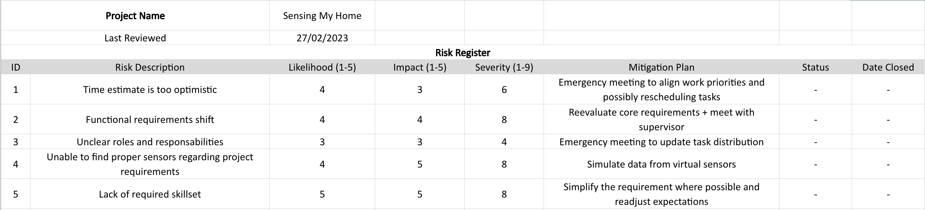
Risk Management Plan

Slide 18
Communication Plan

Slide 19




Development Tools
GitHub
Shared code repository
Use of branches for each subsystem of the system architecture
Use of GitHub Flow for integration of increments
Jira
Agile backlog management for planning and task tracking
Discord
Private server for team communication and organization
Use of different chats for each milestone and for each development submodule
OneDrive
Sharing of internal documents
website
Notes:
--- André ---

Slide 20
Grow Mate

